Slide 1
AWS - TRAINING
EC2
Elastic Cloud Compute

Slide 2
INTRODUCTION
Most popular AWS offering
Broadest and deepest instance choice to match your workload’s needs.
Infra as a service
OS option: Windows , Linux and Mac OS
While launching EC2 we need to select multiple configurations like:
1. VPCU’s
2. RAM
3. Storage Space options(EBS/EFS/EC2 Instance Store).
4.Network Card.
5. Firewall Rules
6. Bootstrap Script(configured at the first launch)

Slide 3
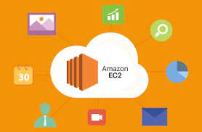
FREE TIER QUOTA OF EC2
AWS offers a Free Tier for Amazon EC2 (Elastic Compute Cloud) that provides a certain amount of usage at no cost for 12 months after you create an AWS account.
Here are some typical Free Tier benefits for Amazon EC2:
1. 750 Hours of EC2 Linux, RHEL, or SLES t2.micro Instances.
2. 750 Hours of EC2 Windows t2.micro Instances.

Slide 4
EC2 INSTANCES TYPES
Amazon EC2 provides a wide selection of instance types optimized to fit different use cases.
Instance types comprise varying combinations of CPU, memory, storage, and networking capacity and give you the flexibility to choose the appropriate mix of resources for your applications.
Each instance type includes one or more instance sizes, allowing you to scale your resources to the requirements of your target workload.
Types:
General Purpose : Instances starting with M or T class(M7g,T2,T3 )
Compute Optimized: Instances starting with C class(C4,C5a)
Memory optimized : Instances starting with R or X class(X1 ,R7)
Storage Optimized : Instances starting with I or D class(D2, D3,I4g)
Link : https://aws.amazon.com/ec2/instance-types/

Slide 5

EC2 NAMING CONVENTION
AWS has the following naming convention:
m5.2xlarge
• m: instance class
• 5: generation (AWS improves them over time)
• 2xlarge: size within the instance class
Link : https://aws.amazon.com/ec2/instance-types/

Slide 6
LET’S DISCUSS SOME USE CASES
General Purpose:
Startups: Small and growing startups often choose General Purpose instances because they are versatile and cost-effective. Startups may use these instances for web hosting, application development, and other general-purpose workloads.
Nonprofit Organizations: Nonprofits with limited budgets often opt for General Purpose EC2 instances for their websites, donation management, and content delivery to support their causes.
Retailers: Retail companies deploy General Purpose EC2 instances to run e-commerce platforms, manage inventory, and perform sales analytics, ensuring that online shopping experiences are efficient and responsive.

Slide 7
COMPUTE OPTIMIZED
1. High-Performance Web Servers: Well-suited for web servers handling a large number of concurrent user requests.
2. Application Servers: Applications that involve intensive data processing, calculations, and business logic can use like ERP systems, financial software, and scientific simulations.
3. Batch Processing: Ideal for batch processing workloads that involve heavy data transformation, ETL (Extract, Transform, Load) jobs, or rendering tasks.
4. Scientific and Engineering Simulations: Scientific research, engineering simulations, and computational chemistry applications often demand a lot of CPU power. Compute Optimized instances can significantly reduce the time required to run simulations and computations.
5. Gaming Servers: Online multiplayer game servers require low-latency, high-performance CPUs to process and respond to player interactions. Compute Optimized instances are a good choice for hosting game servers.
6. HPC (High-Performance Computing) Clusters: Compute Optimized instances are commonly used in high-performance computing clusters for scientific research, weather modeling, and simulations. They can be clustered to work together for parallel computing tasks.

Slide 8
MEMORY OPTIMIZED
Netflix: Netflix uses Memory-Optimized instances to manage its vast catalog of streaming content and user data, ensuring smooth streaming and personalization.
Amazon: Amazon's e-commerce platform leverages Memory-Optimized instances to handle its extensive product catalog, customer data, and order processing.
Facebook: Facebook uses Memory-Optimized instances for its database systems and to optimize memory-intensive workloads within its infrastructure.
Spotify: Spotify employs Memory-Optimized instances to manage its vast music catalog and user preferences.

Slide 9
STORAGE OPTIMIZED
These instances are well-suited for applications that rely heavily on local storage for data-intensive tasks.
Netflix: Netflix uses AWS extensively for its video streaming service. While not all of their workloads may use Storage-Optimized instances, they likely utilize these instances for storage-intensive tasks like managing video content libraries and databases.
Dropbox: Dropbox, a cloud storage and file-sharing service, requires substantial storage capacity to manage user files and data. Storage-Optimized instances are likely used for their data storage and retrieval needs.
Zynga: Zynga, a gaming company known for titles like FarmVille and Words With Friends, manages vast amounts of game-related data. Storage-Optimized instances could be used for game content storage and databases.

Slide 10

HOW MUCH I HAVE TO PAY????

Slide 11
LET’S SEE
The cost of using EC2 instances in Amazon Web Services can vary depending on several factors, including the specific instance type you choose, the region in which you deploy the instances, the pricing model you select, and the duration of your usage.
Instance Type: The cost varies based on the chosen instance type (e.g., t2.micro, m5.large, etc.). More powerful instance types with greater CPU and memory resources tend to be more expensive than smaller, less powerful ones.
Pricing Model: The cost varies on the pricing model you choose like on-Demand , reserved or Spot instances.
Region: AWS pricing can vary by region, and instances in certain regions may be more or less expensive than others.
Additional Cost: You may also incur costs for data transfer, storage (e.g., EBS volumes), and any additional services you use, such as load balancers, data transfer, or database services.
Usage Duration: If you run instances 24/7, you will incur costs for the full duration. If you use instances intermittently, you can stop or terminate them to save costs. AWS provides options like the EC2 Auto Scaling service to automatically adjust the number of instances based on your workload.

Slide 12
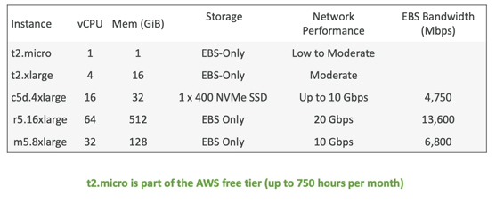
EC2 INSTANCE TYPE EXAMPLE

Slide 13
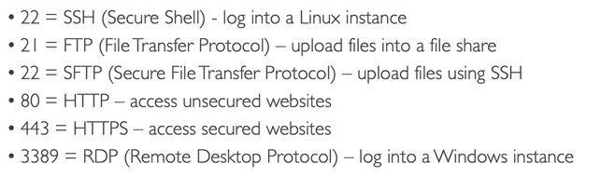
IMPORTANT PORTS TO BE AWARE OF

Slide 14
SSH
Secure Shell is a network communication protocol that enables two computers to communicate and share data in an encrypted manner.
SSH is often used to "login" and perform operations on remote computers but it may also be used for transferring data.
To use SSH we need to have a SSH client at our end which will establish connection and perform operations on server.
SSH client must support SCP(Secure Copy) or SFTP(Simple File Transfer Protocol)
SSH connection to server can be establish in 2 ways:
1. Command Line
2. GUI Based Interface like WINSCP in windows or Cyberduck on Linux

Slide 15
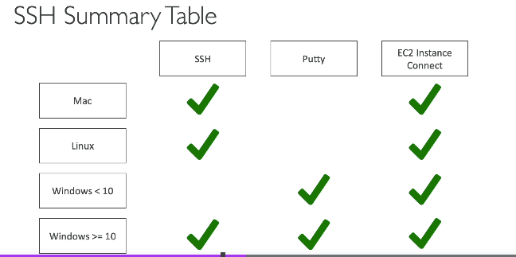

Slide 16
CONNECT TO YOUR LINUX EC2
For Windows User | For Linux User
1.Connect to your Linux instance from Windows with OpenSSH Reference: https://docs.aws.amazon.com/AWSEC2/latest/UserGuide/openssh.html 2. Connect to your Linux instance using putty on windows. Reference: https://docs.aws.amazon.com/AWSEC2/latest/UserGuide/putty.html 3. Connect to your Linux instance using WSL. | Connect to linux EC2 instance from native SSH from Linux System Refernce: https://docs.aws.amazon.com/AWSEC2/latest/UserGuide/connect-linux-inst-ssh.html

Slide 17
LAB 02: CONNECT TO LINUX AND WINDOWS EC2 INSTANCE
Connect to your Linux instance using putty on windows.
Connect to linux EC2 instance from native SSH from Linux System.
Connect to windows EC2 using RDP.
Send File from Linux using SCP protocol.

